Slide 1
CSS

Slide 2
CSS
CSS stands for Cascading Style Sheets
CSS describes how HTML elements are to be displayed on screen, paper, or in other media
CSS is generally used with HTML to change the style of web pages and user interfaces.
Can use CSS to change the color, backgrounds, borders, paddings, margins, fonts, icons, position and various other properties of HTML elements in a web document.
CSS saves a lot of work. It can control the layout of multiple web pages all at once
External stylesheets are stored in CSS files

Slide 3
Applications of CSS
CSS saves time - You can write CSS once and then reuse same sheet in multiple HTML pages. You can define a style for each HTML element and apply it to as many Web pages as you want.
Pages load faster - If you are using CSS, you do not need to write HTML tag attributes every time. Just write one CSS rule of a tag and apply it to all the occurrences of that tag. So less code means faster download times.
Easy maintenance - To make a global change, simply change the style, and all elements in all the web pages will be updated automatically.
Superior styles to HTML - CSS has a much wider array of attributes than HTML, so you can give a far better look to your HTML page in comparison to HTML attributes.
Multiple Device Compatibility - Style sheets allow content to be optimized for more than one type of device. By using the same HTML document, different versions of a website can be presented for handheld devices such as PDAs and cell phones or for printing.
Global web standards - Now HTML attributes are being deprecated and it is being recommended to use CSS. So its a good idea to start using CSS in all the HTML pages to make them compatible to future browsers.

Slide 4
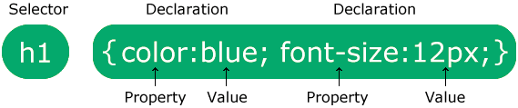
CSS Syntax
A CSS rule consists of a selector and a declaration block.
The selector points to the HTML element you want to style.
The declaration block contains one or more declarations separated by semicolons.
Each declaration includes a CSS property name and a value, separated by a colon.
Multiple CSS declarations are separated with semicolons, and declaration blocks are surrounded by curly braces.

Slide 5
Example:
p { color: red; text-align: center; }
p is a selector in CSS (it points to the HTML element you want to style: <p>).
color is a property, and red is the property value
text-align is a property, and center is the property value

Slide 6
CSS Selectors CSS selectors are patterns used to select and style HTML elements on a web page. They allow you to target specific elements or groups of elements to apply styles like colors, fonts, margins, and more. CSS selectors are a fundamental part of Cascading Style Sheets (CSS), which is a language used to control the presentation and layout of web documents. The element or elements that are selected by the selector are referred to as subject of the selector.
Divide CSS selectors into five categories:
Simple selectors (select elements based on name, id, class)
Combinator selectors (select elements based on a specific relationship between them)
Pseudo-class selectors (select elements based on a certain state)
Pseudo-elements selectors (select and style a part of an element)
Attribute selectors (select elements based on an attribute or attribute value)

Slide 7
Selector lists If same CSS is used by more than one selector, then these selectors can be combined together to form a selector list. Thus the CSS rule is applied to all the individual selectors.
p {
color: crimson;
}
.sample {
color: crimson;
}
p, .sample {
color: crimson;
}
The syntax will be deemed invalid, if one of the selector is invalid (..sample - is an incorrect way of defining a class)

Slide 8
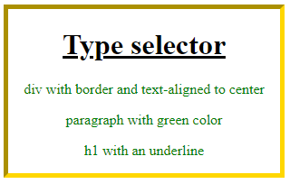
CSS Selector - Type Selector A type selector targets an HTML element, such as <h1>, <p>, etc.
<html>
<head>
<style>
div {
border: 5px inset gold;
width: 300px;
text-align: center;
}
p {
color: green;
}
h1 {
text-decoration-line: underline;
}
</style>
</head>
<body>
<div>
<h1>Type selector</h1>
<p>div with border and text-aligned to center</p>
<p>paragraph with green color</p>
<p>h1 with an underline</p>
</div>
</body>
</html>

Slide 9
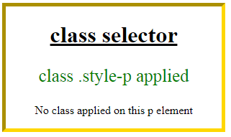
CSS Selector - Class Selector A class selector targets an element with a specific value for its class attribute..
Following example demonstrates the use of a class selector, where .style-p, .style-h1 and .style-div are class selectors:
<html>
<head>
<style>
.style-div {
border: 5px inset gold;
width: 300px;
text-align: center;
}
.style-p {
color: green;
font-size: 25px;
}
.style-h1 {
text-decoration-line: underline;
}
</style>
</head>
<body>
<div class="style-div">
<h1 class="style-h1">class selector</h1>
<p class="style-p">class .style-p applied</p>
<p>No class applied on this p element</p>
</div>
</body>
</html>

Slide 10
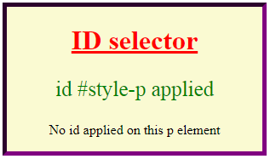
CSS Selector - ID Selector An ID selector targets an element with a specific value for its id attribute.
Following example demonstrates the use of an id selector, where #style-p, #style-h1 and #style-div are the ide selectors applied on the elements:
<html>
<head>
<style>
#style-div {
border: 5px inset purple;
width: 300px;
text-align: center;
background-color: lightgoldenrodyellow;
}
#style-p {
color: green;
font-size: 25px;
}
#style-h1 {
text-decoration-line: underline;
color: red;
}
</style>
</head>
<body>
<div id="style-div">
<h1 id="style-h1">ID selector</h1>
<p id="style-p">id #style-p applied</p>
<p>No id applied on this p element</p>
</div>
</body>
</html>

Slide 11
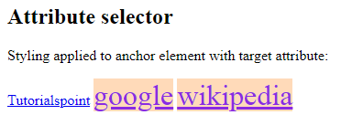
CSS Selector - Attribute Selector An attribute selector targets an element based on a specific attribute or attribute values on an element.
<html>
<head>
<style>
a[target] {
background-color: peachpuff;
color: blueviolet;
font-size: 2em;
}
</style>
</head>
<body>
<h2>Attribute selector</h2>
<p>Styling applied to anchor element with target attribute:</p>
<a href="#">Tutorialspoint</a>
<a href="#" target="_blank">google</a>
<a href="#" target="_self">wikipedia</a>
</body>
</html>
You can also specify the element with an attribute having a specific value.

Slide 12
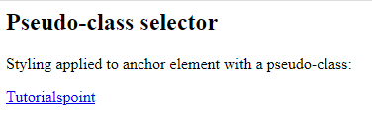
CSS Selector - Pseudo-class Selector A pseudo-class selector is used to style a specific state of an element, such as :hover is used to style an element when hovered.
<html>
<head>
<style>
a:hover {
background-color: peachpuff;
color: green;
font-size: 2em;
}
</style>
</head>
<body>
<h2>Pseudo-class selector</h2>
<p>Styling applied to anchor element with a pseudo-class:</p>
<a href="#">Tutorialspoint</a>
</body>
</html>

Slide 13
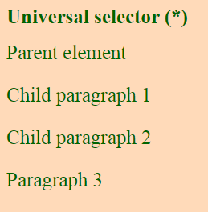
CSS Selector - Universal Selector Universal selector, denoted by an asterisk mark (*), is a special selector that matches any and all elements in an HTML document.
<html>
<head>
<style>
* {
background-color: peachpuff;
color: darkgreen;
font-size: 25px;
}
</style>
</head>
<body>
<h1>Universal selector (*)</h1>
<div>Parent element
<p>Child paragraph 1</p>
<p>Child paragraph 2</p>
</div>
<p>Paragraph 3</p>
</body>
</html>

Slide 14
The CSS Grouping Selector
The grouping selector selects all the HTML elements with the same style definitions.
Look at the following CSS code (the h1, h2, and p elements have the same style definitions):
h1, h2, h3 {
color: #36C;
font-weight: normal;
letter-spacing: .4em;
margin-bottom: 1em;
text-transform: lowercase;
}

Slide 15
Three Ways to Insert CSS
There are three ways of inserting a style sheet:
Internal or Embedded CSS
External CSS
Inline CSS

Slide 16

Inline CSS - The style Attribute
You can use style attribute of any HTML element to define style rules. These rules will be applied to that element only.
Here is the generic syntax −
<element style = "...style rules....">
Attributes
Example
Following is the example of inline CSS based on the above syntax −
Attribute | Value | Description
style | style rules | The value of style attribute is a combination of style declarations separated by semicolon (;).
<html>
<head>
</head>
<body>
<h1 style = "color:#36C;">
This is inline CSS
</h1>
</body>
</html>

Slide 17
External CSS - The <link> Element
The <link> element can be used to include an external stylesheet file in your HTML document.
An external style sheet is a separate text file with .css extension. You define all the Style rules within this text file and then you can include this file in any HTML document using <link> element.
Here is the generic syntax of including external CSS file −
<head> <link type = "text/css" href = "..." media = "..." /> </head>
Attribute | Value | Description
type | text css | Specifies the style sheet language as a content-type (MIME type). This attribute is required.
href | URL | Specifies the style sheet file having Style rules. This attribute is a required.
media | Screen, Tv, projector handheld Print, braille Aural, all | Specifies the device the document will be displayed on. Default value is all. This is optional attribute.

Slide 18
External CSS - The <link> Element contd…
Example
Consider a simple style sheet file with a name mystyle.css having the following rules −
h1, h2, h3 {
color: #36C;
font-weight: normal;
letter-spacing: .4em;
margin-bottom: 1em;
text-transform: lowercase;
}
Now you can include this file mystyle.css in any HTML document as follows −
<head>
<link type = "text/css" href = "mystyle.css" media = " all" />
</head>

Slide 19
CSS Links
Styling Links
Links can be styled with any CSS property (e.g. color, font-family, background, etc.).
a { color: hotpink; }
In addition, links can be styled differently depending on what state they are in.
The four links states are:
a:link - a normal, unvisited link
a:visited - a link the user has visited
a:hover - a link when the user mouses over it
a:active - a link the moment it is clicked

Slide 20
Set the Color of Links
<html>
<head>
<style type = "text/css">
a:link {color: #000000}
a:visited {color: #006600}
a:hover {color: #FFCC00}
a:active {color: #FF00CC}
</style> </head>
<body>
<a href = "">Link</a>
</body>
</html>

